Slide 1
Switching

Slide 2
Introduction
How two devices perform communication when there are many devices
One alternative is to establish point –point communication between each pair of devices using mesh topology or star topology
A better solution is switching
A switched network consists of a series of interlinked nodes called switches
Switches are devices creating temporary connections between two or more devices

Slide 3
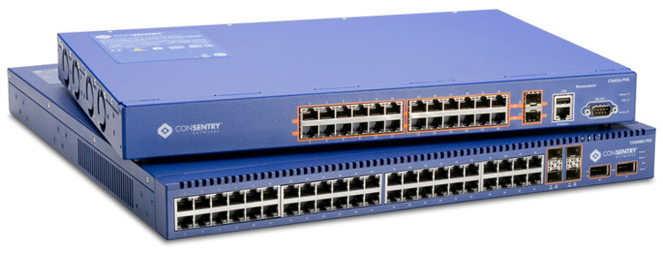

Slide 4
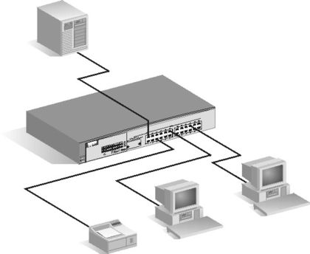

Slide 5
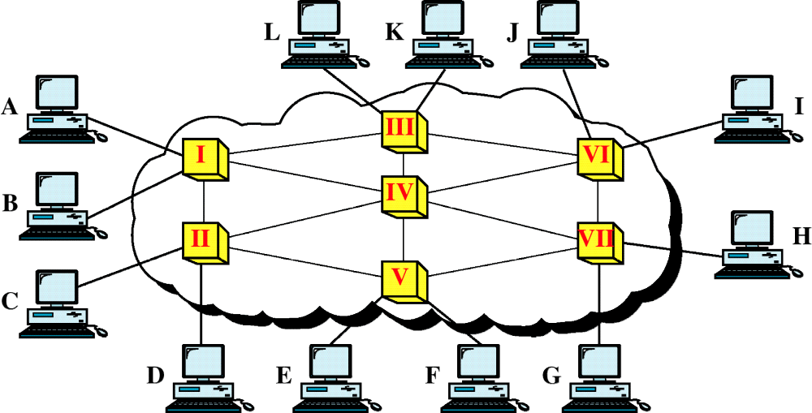
Switched Network

Slide 6
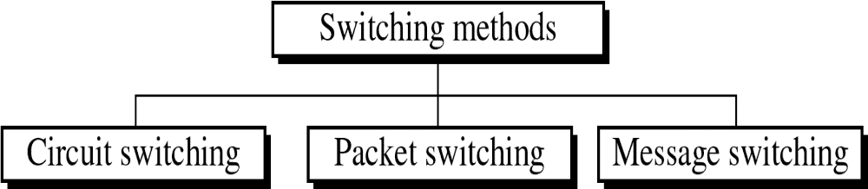

Slide 7
Circuit –Switched network
A circuit switched network consists of a set of switches connected by physical links
Connection is dedicated path made up of two or more links
The links is divided into n channels by using FDM and TDM
Three phase
  Set up phase
  Data transfer phase
  Teardown phase

Slide 8
Circuit –Switched network
Circuit switching takes place at the physical layer
Before starting communication station must reservation the resources
  Bandwidth in FDM and time slots in TDM
  Switch buffers
  Switch processing time
  Switch input and output ports
  Data transfer

Slide 9
Circuit –Switched network
Data transferred between the two stations are not packets ie signals
There is no addressing involved during data transfer
Switches route the data based used during their setup phase
In circuit switch resources are need to be reserved during setup phase
The resource remain dedicated for entire duration until teardown phase

Slide 10
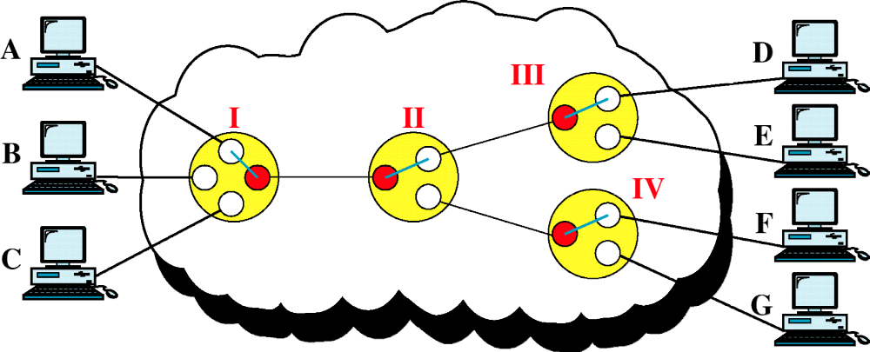
Circuit-Switched Network

Slide 11
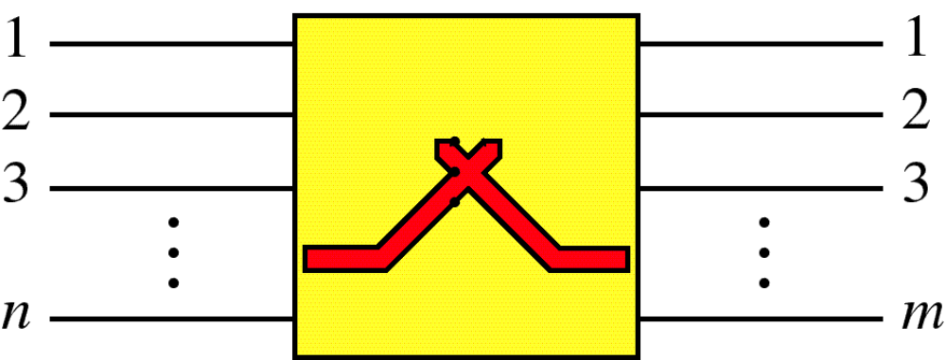
Switch

Slide 12
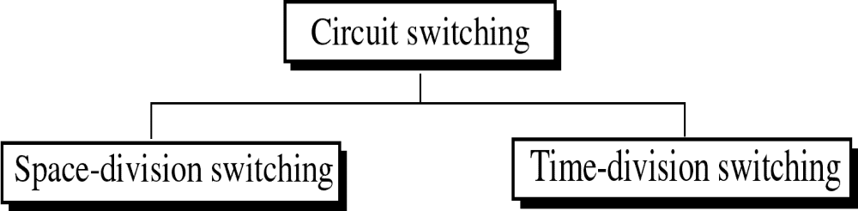

Slide 13
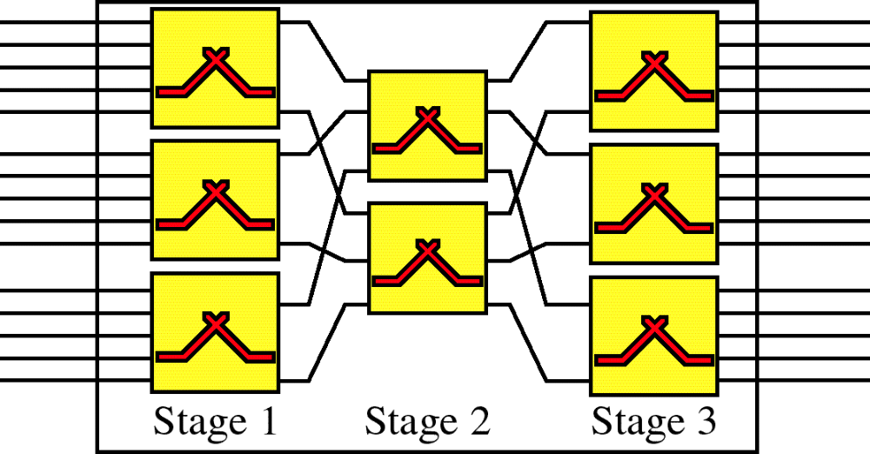
Multistage Switch

Slide 14
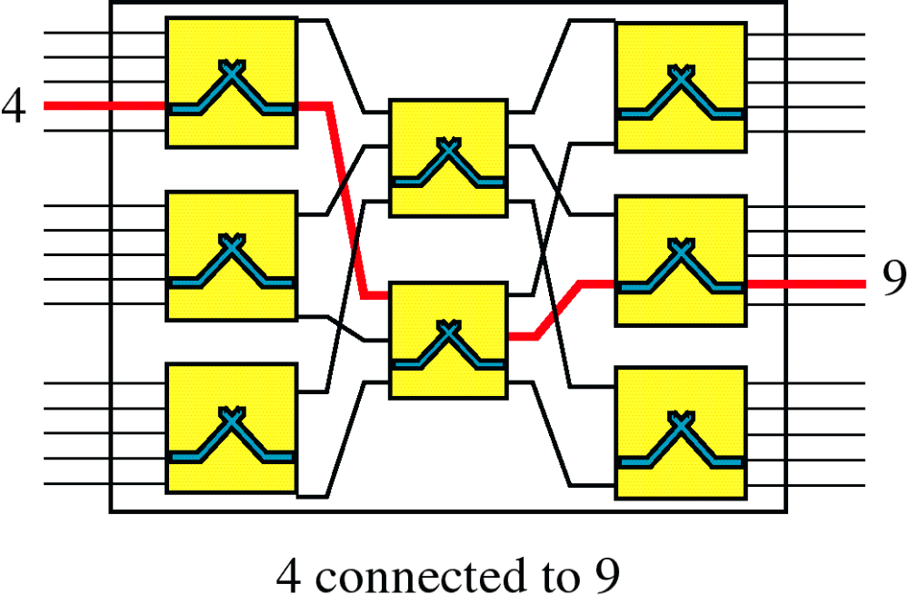
Switching Path

Slide 15
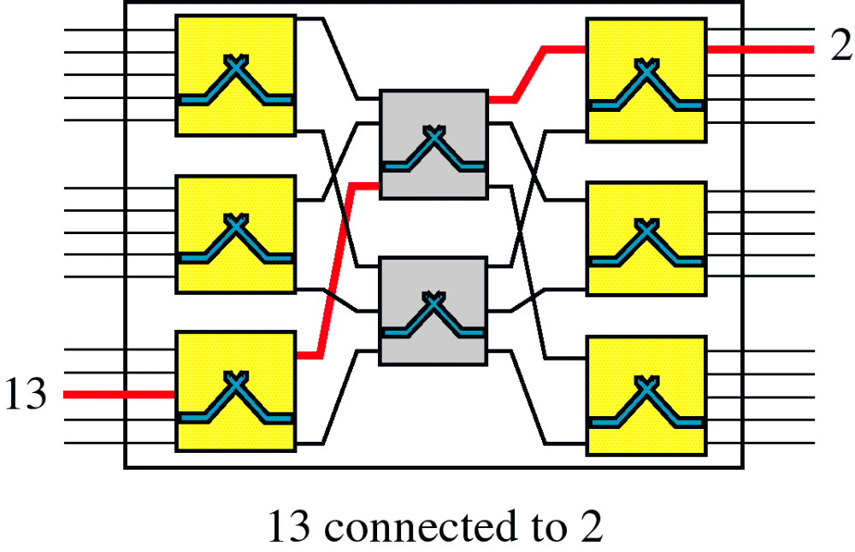
Switching Path

Slide 16
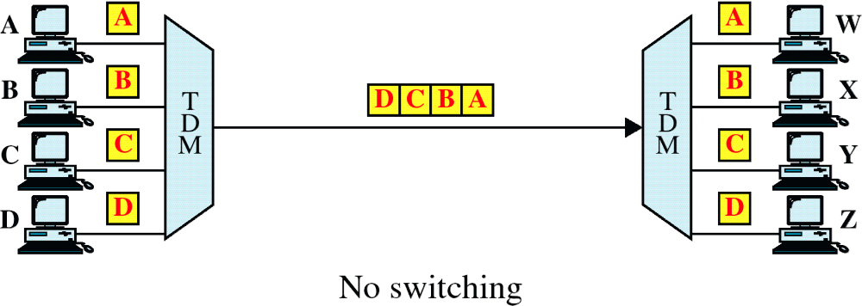
TDM without TSI

Slide 17
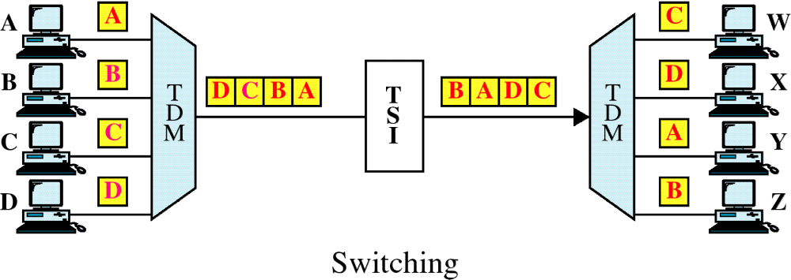
TDM with Time Slot Interchange

Slide 18
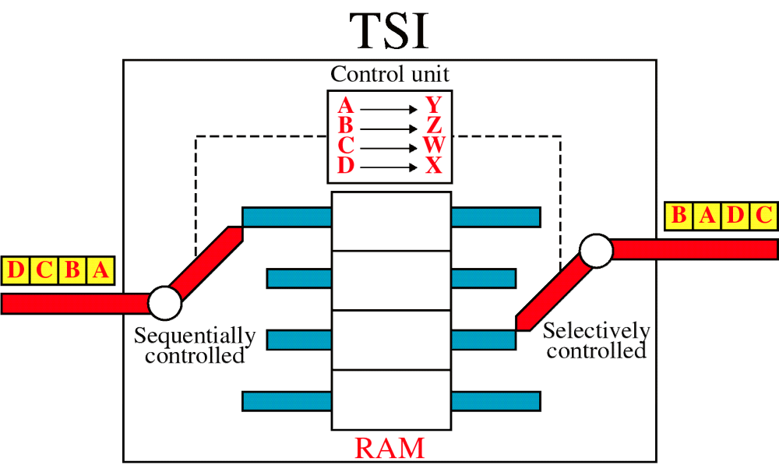
Time-Slot Interchange

Slide 19
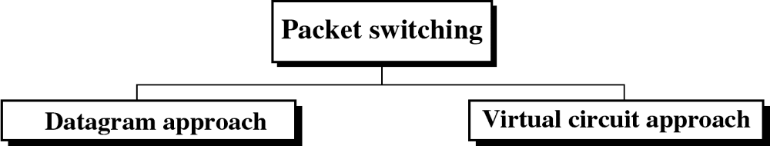

Slide 20
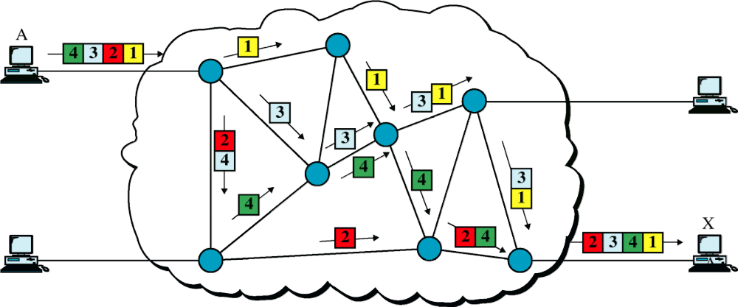
Datagram Approach

Slide 21
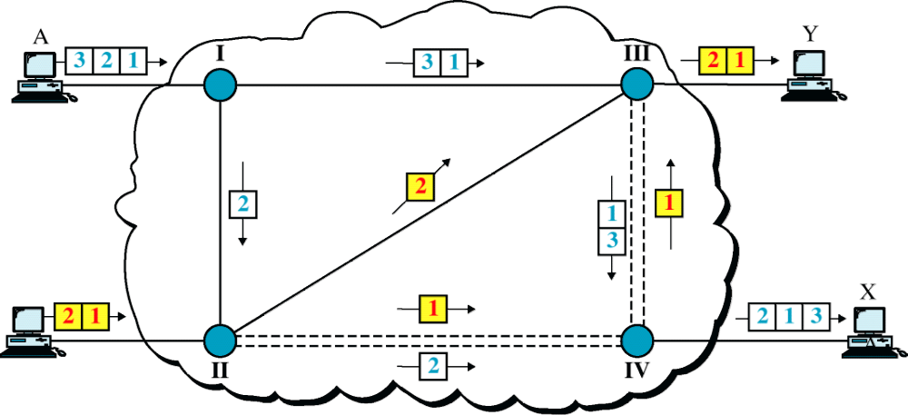
Datagram Approach, Multiple Channels

Slide 22
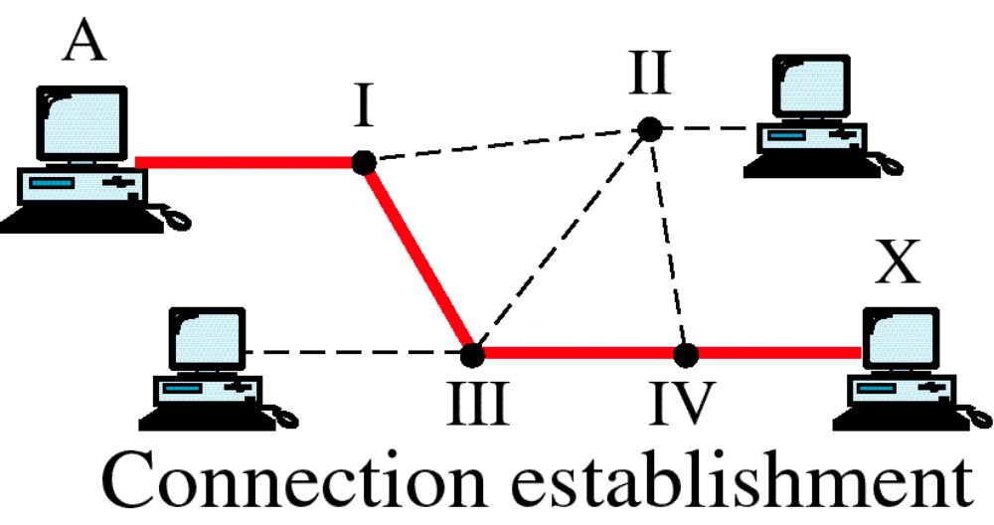
Switched Virtual Circuit

Slide 23
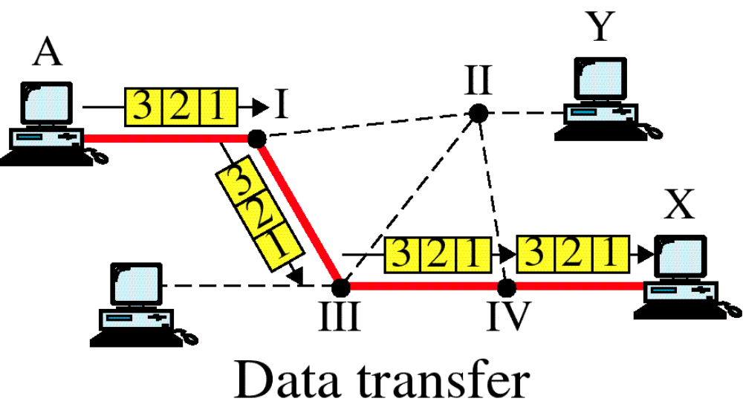
Switched Virtual Circuit

Slide 24
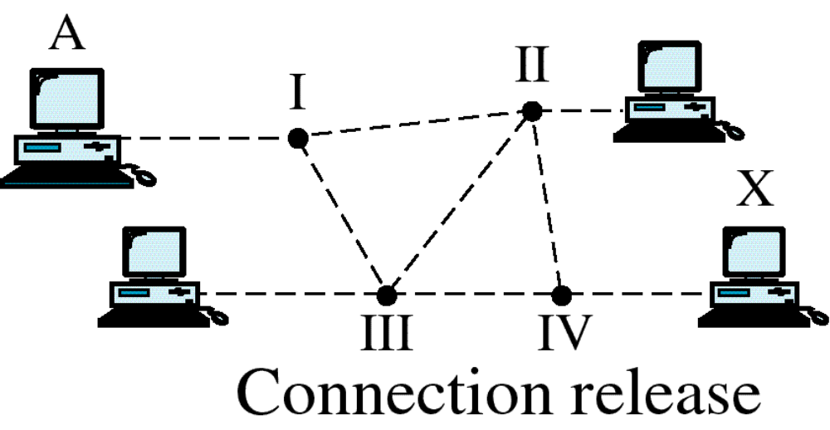
Switched Virtual Circuit

Slide 25
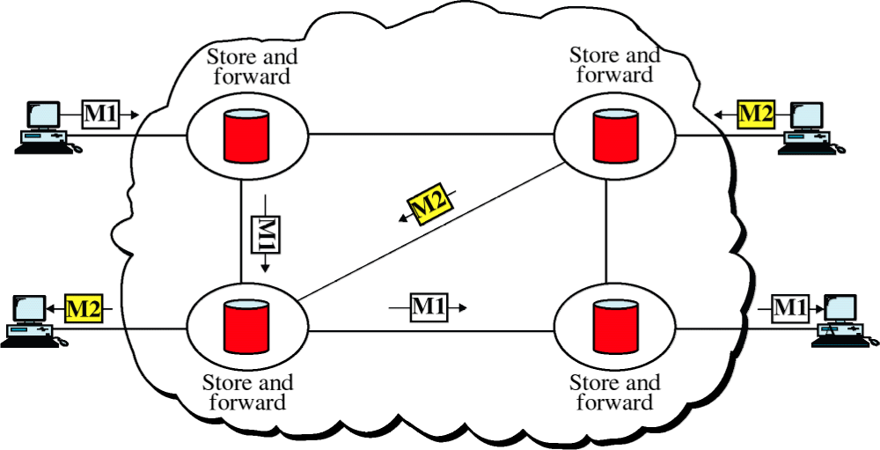
Message Switching

